Slide 1
Introduction to MongoDB

Slide 2
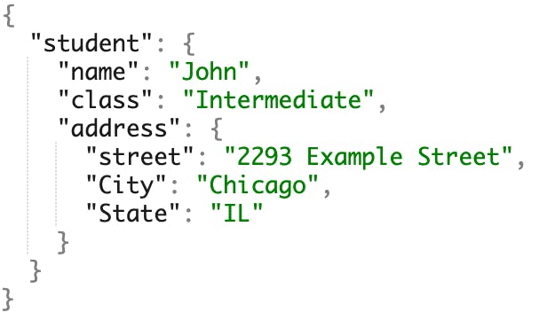
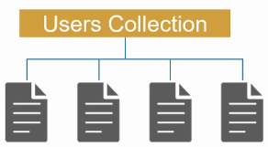
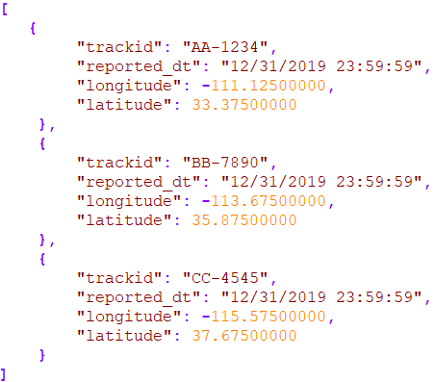
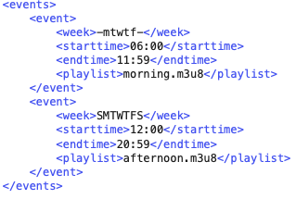
NoSQL Databases
SQL databases, or relational databases, are great at handling transactional data
However, do not scale well, and are too slow for analytics. They are also sometimes too strict in terms of data structures
NoSQL databases are designed with different specific purposes, but in general, are more flexible on data structures
Note that NoSQL does not necessarily mean Not using SQL, but rather Not Only SQL
Data formats in NoSQL are not relational
NoSQL databases scale better with large amounts of data and are more suitable for some classes of data analytics
Key
Value
Key
Value
Key
Value
Key
Value

Slide 3
Types of NoSQL Databases
Document database
Stores data in documents that are similar to JSON structures
Key-Value database
Stores data as key-value pairs
Column-family
Stores data in tables with dynamic columns – in a single table, some rows may have certain columns and other rows have different set of columns
Graph database
Stores data as graphs – objects that represent entities and their relationships

Slide 4
NoSQL Database Advantages
More flexible than relational database and can handle semi-structured or unstructured data
Scale better to large data sizes. Leverage distributed systems
More specialized, therefore provide better performances on their specific types of data and applications

Slide 5
MongoDB
Is a document database
Data is stored in Collections that are similar to SQL table in RDB
A collection has many documents that are equivalent to records in RDB
A key/value pair is similar to a value in a column of a record in RDB
Relational
Database
MongoDB
Database
id | Name | netid
01342 | Alice Smith | Asmith14
012502 | Bob Willams | bwilli21
students {
{
“id”: 01342,
“name”: “Alice Smith”,
“netid”: “asmith14”
},
{
“id”: 12502,
“name”: “Bob William”,
“netid”: “bwilli21”
}
}
Collection 2 {
{
field 1: value 1,
field 2: value 2,
…
},
{
field 1: value 1,
field 2: value 2,
…
}
}

Slide 6
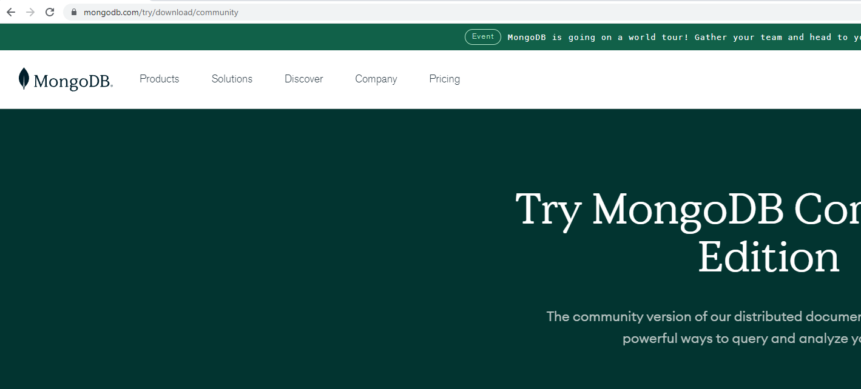
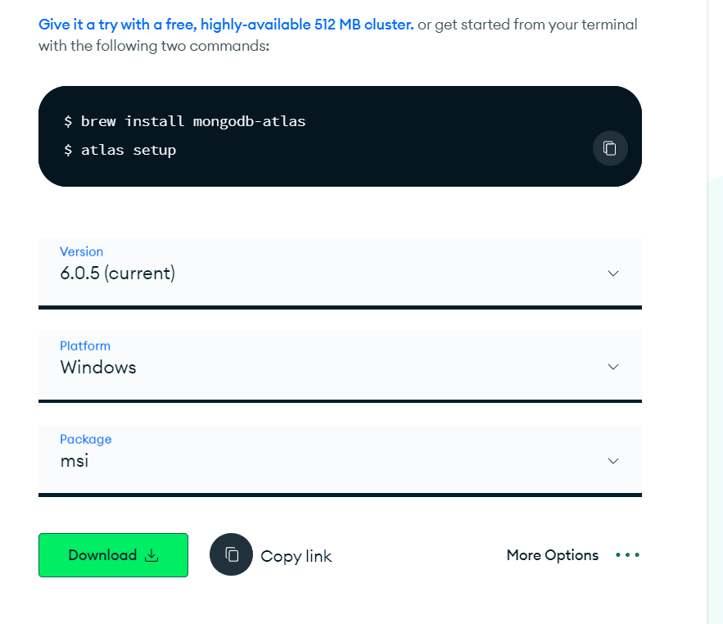
MongoDB Installation
Go to https://www.mongodb.com/try/download/community
Select the correct installation settings for your computer
Download the MongoDB community server installation file and start

Slide 7
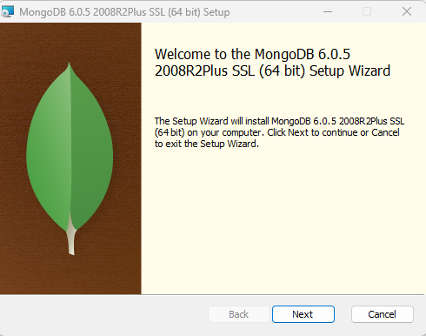
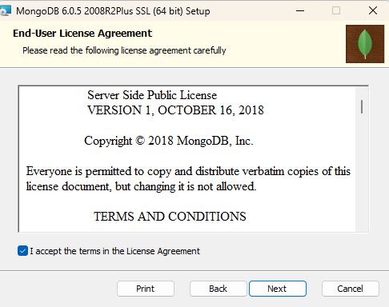
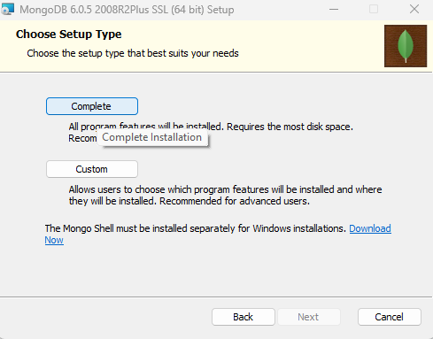
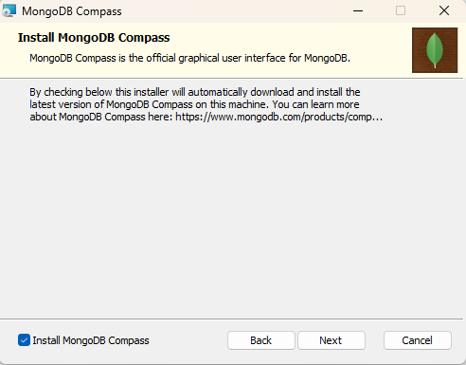
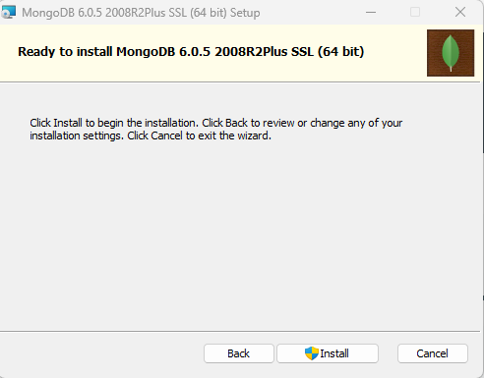
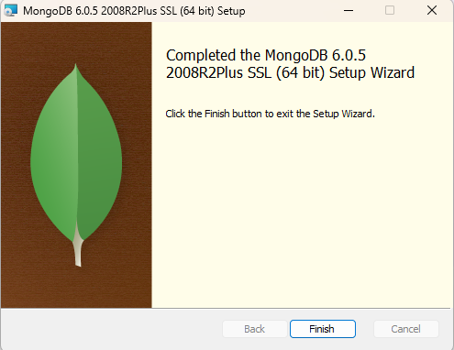
Installation is straightforward, mostly just Next

Slide 8
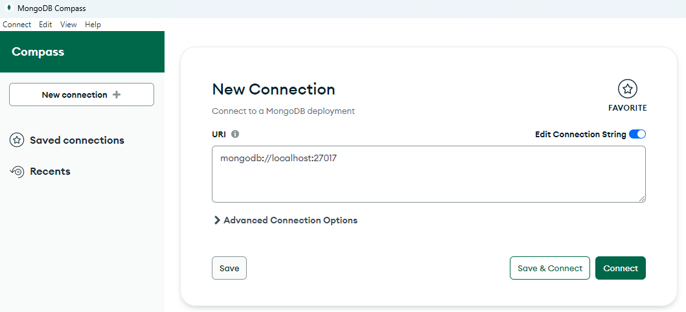
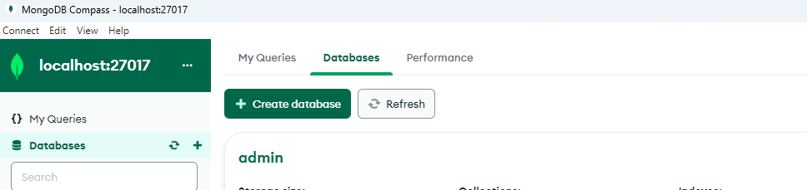
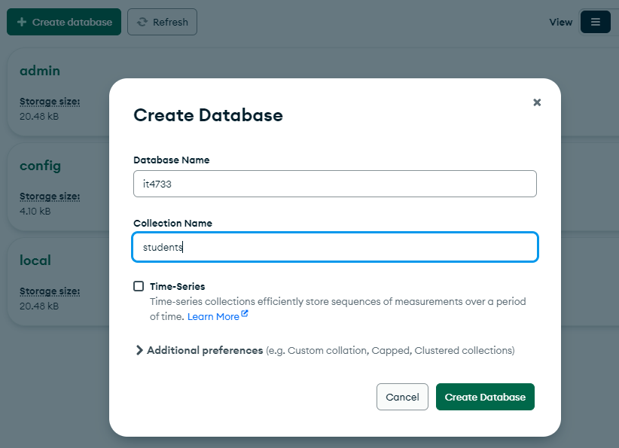
MongoDB Compass
After MongoDB installation is completed, start MongoDB Compass (it may be started automatically for you)
Select Connect in New Connection
You will be connected to the MongoDB instance that is running in your background
Select Create database
Enter the information
Database Name: it4733
Collection Name: students
Click on Create Database

Slide 9
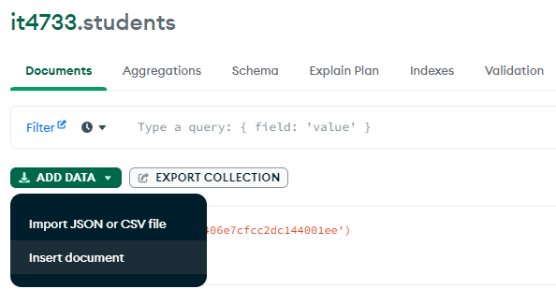
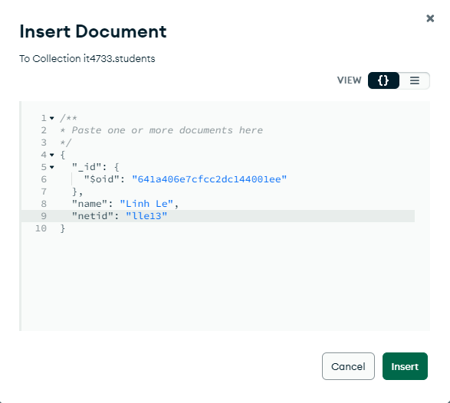
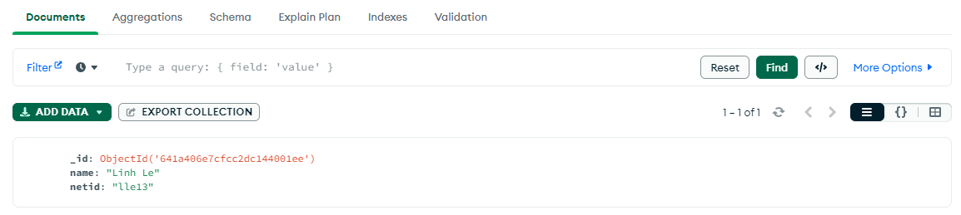
Insert Document
In the GUI of students collection
Select ADD DATA → Insert Document
Edit the text to look similar to my example, but replace my information with yours
Don’t forget to add “,” after the closing bracket of “_id”
Click on Insert
Verify that the document is inserted

Slide 10
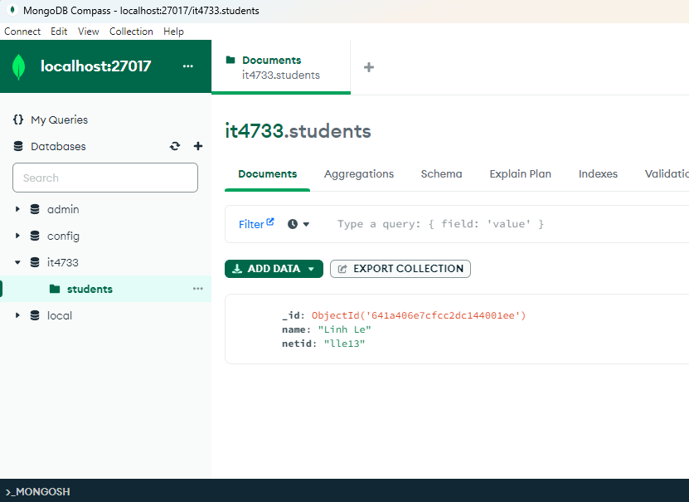
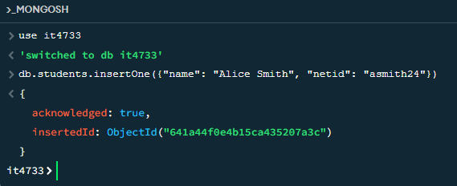
Using MongoDB Shell
Click on MONGOSH at the bottom left of the collection GUI to open the MongoDB shell
Run the following scripts to insert documents into students:
use it4733
db.students.insertOne({"name": "Alice Smith", "netid": "asmith24"})

Slide 11
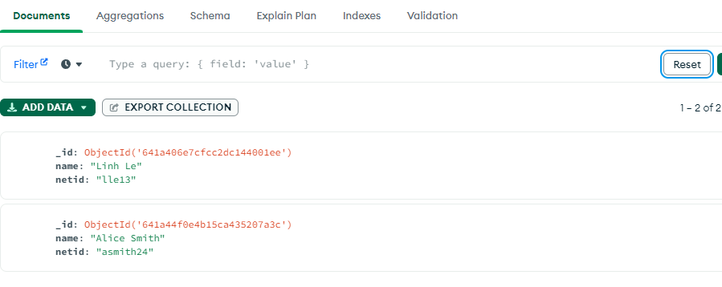
Assignment
Please follow all the previous instructions to add two documents to your students collection
The first student should have your information, not mine
Please take a screenshot similar to below and submit

Slide 12
More Readings
https://aws.amazon.com/nosql/#:~:text=NoSQL%20databases%20use%20a%20variety,consistency%20restrictions%20of%20other%20databases
https://www.mongodb.com/nosql-explained

